Slide 1
INTEL UNNATI PROJECT
Intel Products Sentiment Analysis from Online Reviews
BY PRANAY VUNNAM

Slide 2
Introduction-PROBLEM STATEMENT
Problem statement:-
Intel Products Sentiment Analysis from Online Reviews
Under End Users/Buyers Reviews Category
This project is based on sentiment analysis of user reviews from e-commerce websites of intel products.

Slide 3
Objectives-UNIQUE IDEA BRIEF
To scrap the reviews available on different sources in the last 3 - 5 years.
Applying various exploratory data analysis, machine learning and natural programming techniques to find the sentiments of products, clustering of affinity reviews, trends of sentiments over period of time,
Features and keywords extraction to specific sentiments, recommendation on key improvements based on users reviews for future products.
Key Summary and Recommendations based on analysis and model outcomes.

Slide 4
Scraping and Preprocessing Of the Data
From textual data ,the preprocessing of the data has been started . After that feature extraction and classification process has begun and finally led to prediction of the Sentimental Analysis.
Generated the datasets by using a library called Synthetic data for Intel Processors like i3,i5,i7,i9.
Analysis of Data-Successfully demonstrated sentimental analysis and was able to differentiate the data into positive or neutral or negative sentiment analysis.
Data Cleaning- Data Cleaning has been done to check uppercase and lowercase characters and use of special characters like !,@ etc and scrapping of white spaces.
Under Sentimental Analysis ,successfully differentiated the reviews into positive or neutral or neutral by usage of keywords.
For example:- Happy still sing beyond. Address again school town control little page. Yourself often this. Excellent product!
Here the result lead to positive as the keyword excellent product gives a clear indication that it is positive sentiment analysis.

Slide 5
About the model
To test and train the data
By using Naive Bayes Classifier-
Uses of Naive Bayes Classifier
Simplicity and Ease of Implementation: Easy to implement with straightforward underlying principles.
Efficiency and Speed: Fast training and prediction, suitable for large datasets and real-time applications.
Good Performance with Small Datasets: Often performs well even with smaller datasets where more complex models may struggle.
Effective with High-Dimensional Data: Works well with text data, which is typically high-dimensional.
Probabilistic Interpretation: Provides class probabilities, offering insights into prediction confidence.
Handles Sparse Data: Efficiently manages sparse matrices common in text data.
Strong Baseline Model: Provides a robust benchmark to compare against more complex models.
Specialized for Text Data: The Multinomial Naive Bayes variant is particularly effective for frequency-based text features.

Slide 6
Outcomes
Sharing models and outputs for above expected use cases along with performance metrics of each model.
Outcomes of the sentiment analysis have been displayed by the use of pie chart given below.
All the reviews have been randomised and have taken 50 random inputs from the datasets and has been classified as positive or neutral or negative based on statistical data.

Slide 7
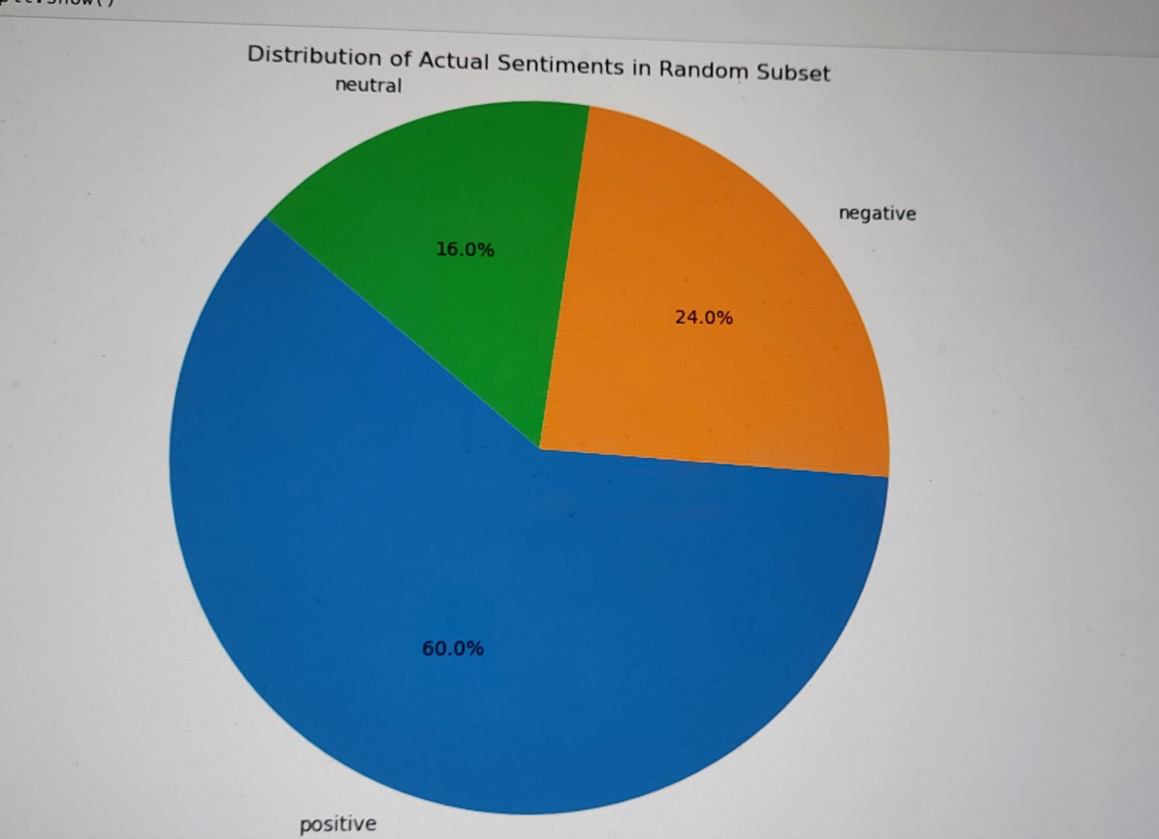
Sentiment Analysis in the form of Pie chart

Slide 8
Features Offered
Web Scraping:
Gathering review data from various online sources.
Data Cleaning And Preprocessing:
Preparing text data for analysis.
Sentiment Analysis:
Using Naive Bayes Classifier to analyse the text data.
Visual Representation:
Displaying sentiment distribution and other insights through graphs and charts.

Slide 9
FLOWCHART
START
Collection of Data
Scraping of Data
Data Cleaning and Preprocessing of data
Sentiment Analysis
Data Visualization
STOP

Slide 10
Features indicated by Sentiment Analysis
Features of getting positive,factors-
Review for Intel Core i5: War speech ever bank especially part hit. Excellent product!
Review for Intel Core i7: Watch any goal notice return. Attorney always data growth current exist. As best area civil single. Excellent product!
Feature of getting Negative ,factors-
Review for Intel Core i8: Create technology entire charge. Instead should call national ten. Terrible product!
Review for Intel Core i9: Certainly improve reflect executive much. Foreign read people could level. Terrible product!
Features of getting Neutral ,factors-
Review for Intel Core i9: Member argue every on consider treatment. Life summer indicate discuss professional receive him really. Average product.
Review for Intel Core i7: Shoulder office west national growth enjoy door memory. Average product.

Slide 11
Recommendations
We can also make sentiment analysis using user information and make categories based on various age groups
We can also display sentiment analysis using user information and can differentiate based on gender
WE can also make data and display results more accurate by using other classifiers and use of data in an efficient manner
Using sentiment analysis APIs provided by cloud services (e.g., Google Cloud Natural Language API, AWS Comprehend) which are optimized for performance and can handle scalability concerns.
Use sparse vector representations like HashingVectorizer which can be faster and more memory-efficient compared to dense vector representations.

Slide 12
Conclusion
This project inferred about the web scraping of data and using Naive bayes classifiers ,successfully demonstrated the Sentiment Analysis.
Identified trends and other insights in sentiment data
Moreover,there was efficient extraction of data and used classification report in sentiment analysis.
Majority of the reviews were of positive sentiment analysis followed by negative sentiment analysis.

Slide 13
THANK YOU

